Slide 1
Introduction to Cyber Security
Module 0
Program Elective
UG 3 Monsoon 2022

Slide 2
Importance of Cyber Security
“The only system which is truly secure is one which is switched off and unplugged, locked in a titanium safe, buried in a concrete bunker, and is surrounded by nerve gas and very highly paid armed guards. Even then, I wouldn’t stake my life on it.”
- Professor Gene Spafford
In security matters:
There is nothing like absolute security
We are only trying to build comfort levels, because security costs money and lack of it costs much more
Comfort level is a manifestation of efforts as well as a realization of their
effectiveness & limitations

Slide 3
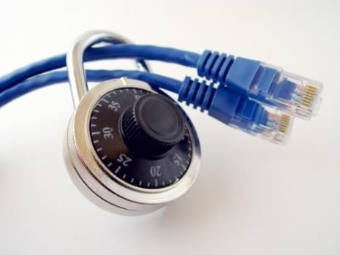
Importance of Cyber Security
The Internet allows an attacker to work from anywhere on the planet.
Risks caused by poor security knowledge and practice:
  Identity Theft
  Monetary Theft
  Legal Ramifications (for yourself and your organization)
  Sanctions or termination if policies are not followed
According to the SANS Institute, the top vectors for vulnerabilities available to a cyber criminal are:
  Web Browser
  IM Clients
  Web Applications
 Excessive User Rights

Slide 4
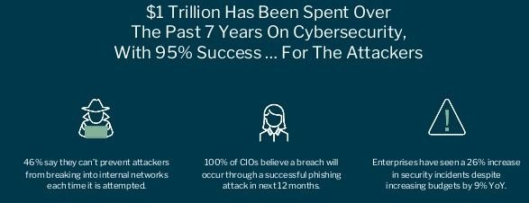
Cyber Security
Cyber security refers to the body of technologies, processes, and practices designed to protect networks, devices, programs, and data from attack, damage, or unauthorized access.

Slide 5
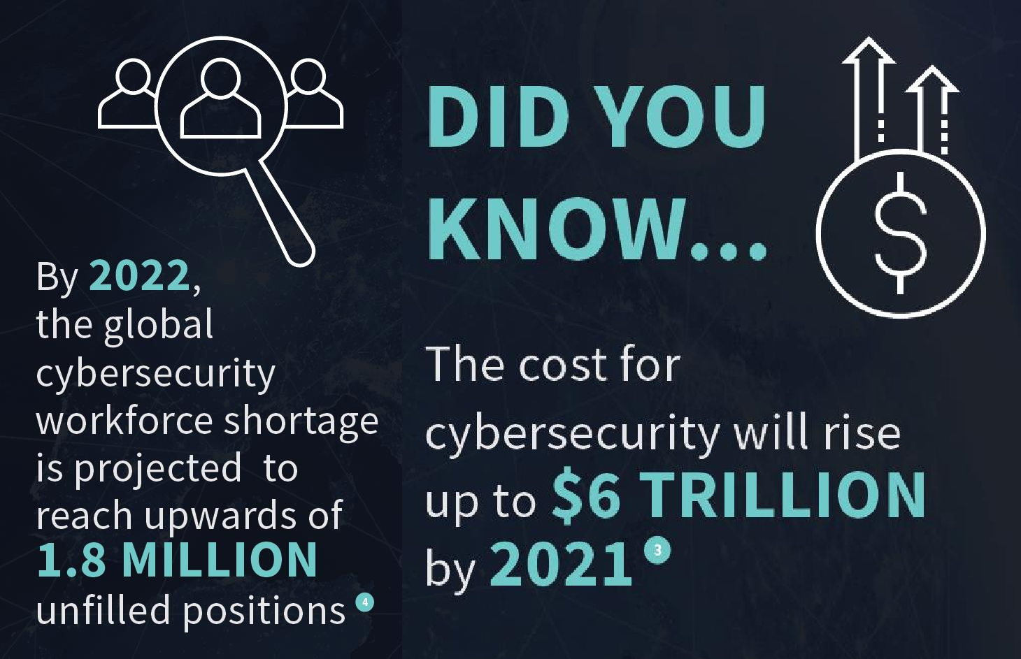
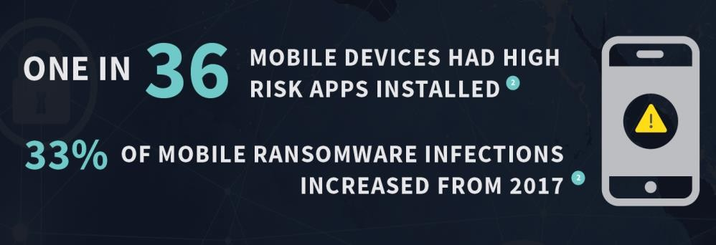
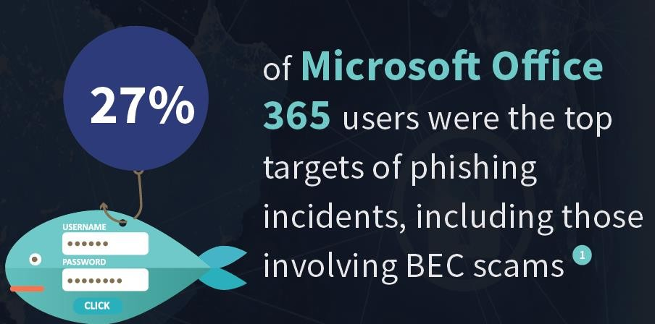

Cyber Security
https://www.varonis.com/blog/data-breach-statistics/

Slide 6
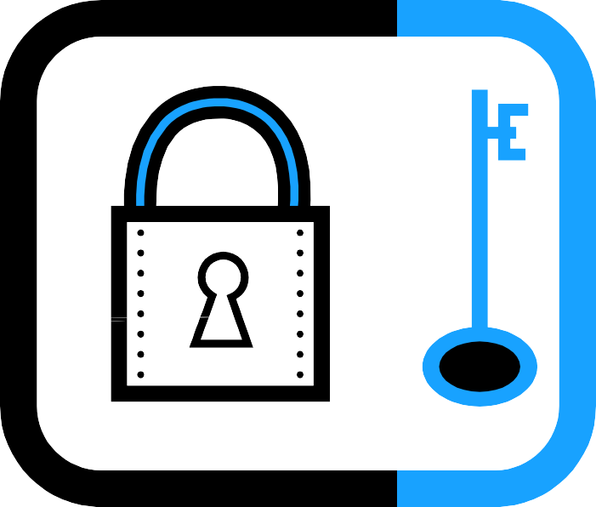
Cyber Security is Safety
Security: We must protect our computers and data in the same way that we secure the doors to our homes.
Safety: We must behave in ways that protect us against risks and threats that come with technology.

Slide 7
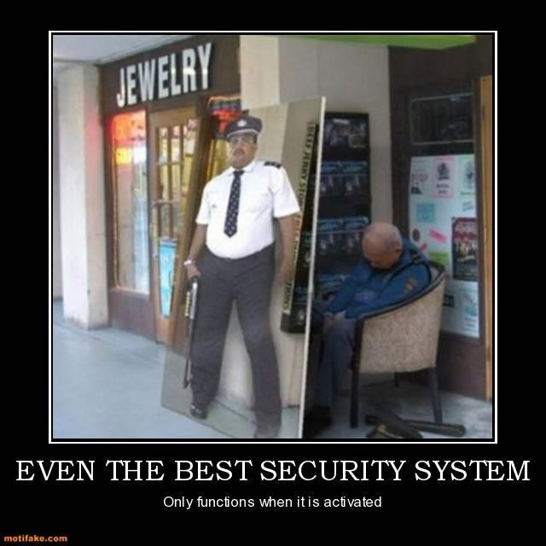
False Sense of Security?

Slide 8
What is a Secure System? (CIA Triad)
Confidentiality – restrict access to authorized individuals
Integrity – data has not been altered in an unauthorized manner
Availability – information can be accessed and modified by authorized individuals in an appropriate timeframe
Availability

Slide 9
CIA Triad
Confidentiality
Example:
Criminal steals
customers’ usernames, passwords, or credit card information
Protecting information from unauthorized access and disclosure

Slide 10
CIA Triad
Integrity
Protecting information from unauthorized modification
Example:
Someone alters payroll information or a proposed product design

Slide 11
CIA Triad
Availability
Example:
Your customers are unable to access your online services
Preventing disruption in how information is accessed

Slide 12
Threats and Vulnerabilities
◆ What are we protecting our and our stakeholders information from?
Threats: Any circumstances or events that can potentially harm an information system by disclosing the information stored on the system, adversely modifying data, or making the system unavailable
Vulnerabilities: Weakness in an information system or its components that could be exploited.
Threats exploit vulnerabilities. Threats sometimes
referred to as Attacks.

Slide 13
Cyber Crime
Cyber Crime is a generic term that refers to all criminal activities done using the medium of communication devices, computers, mobile phones, tablets etc. It can be categorized in three ways:
The computer as a target – attacking the computers of others.
The computer as a weapon- Using a computer to commit
“traditional crime” that we see in the physical world.

Slide 14
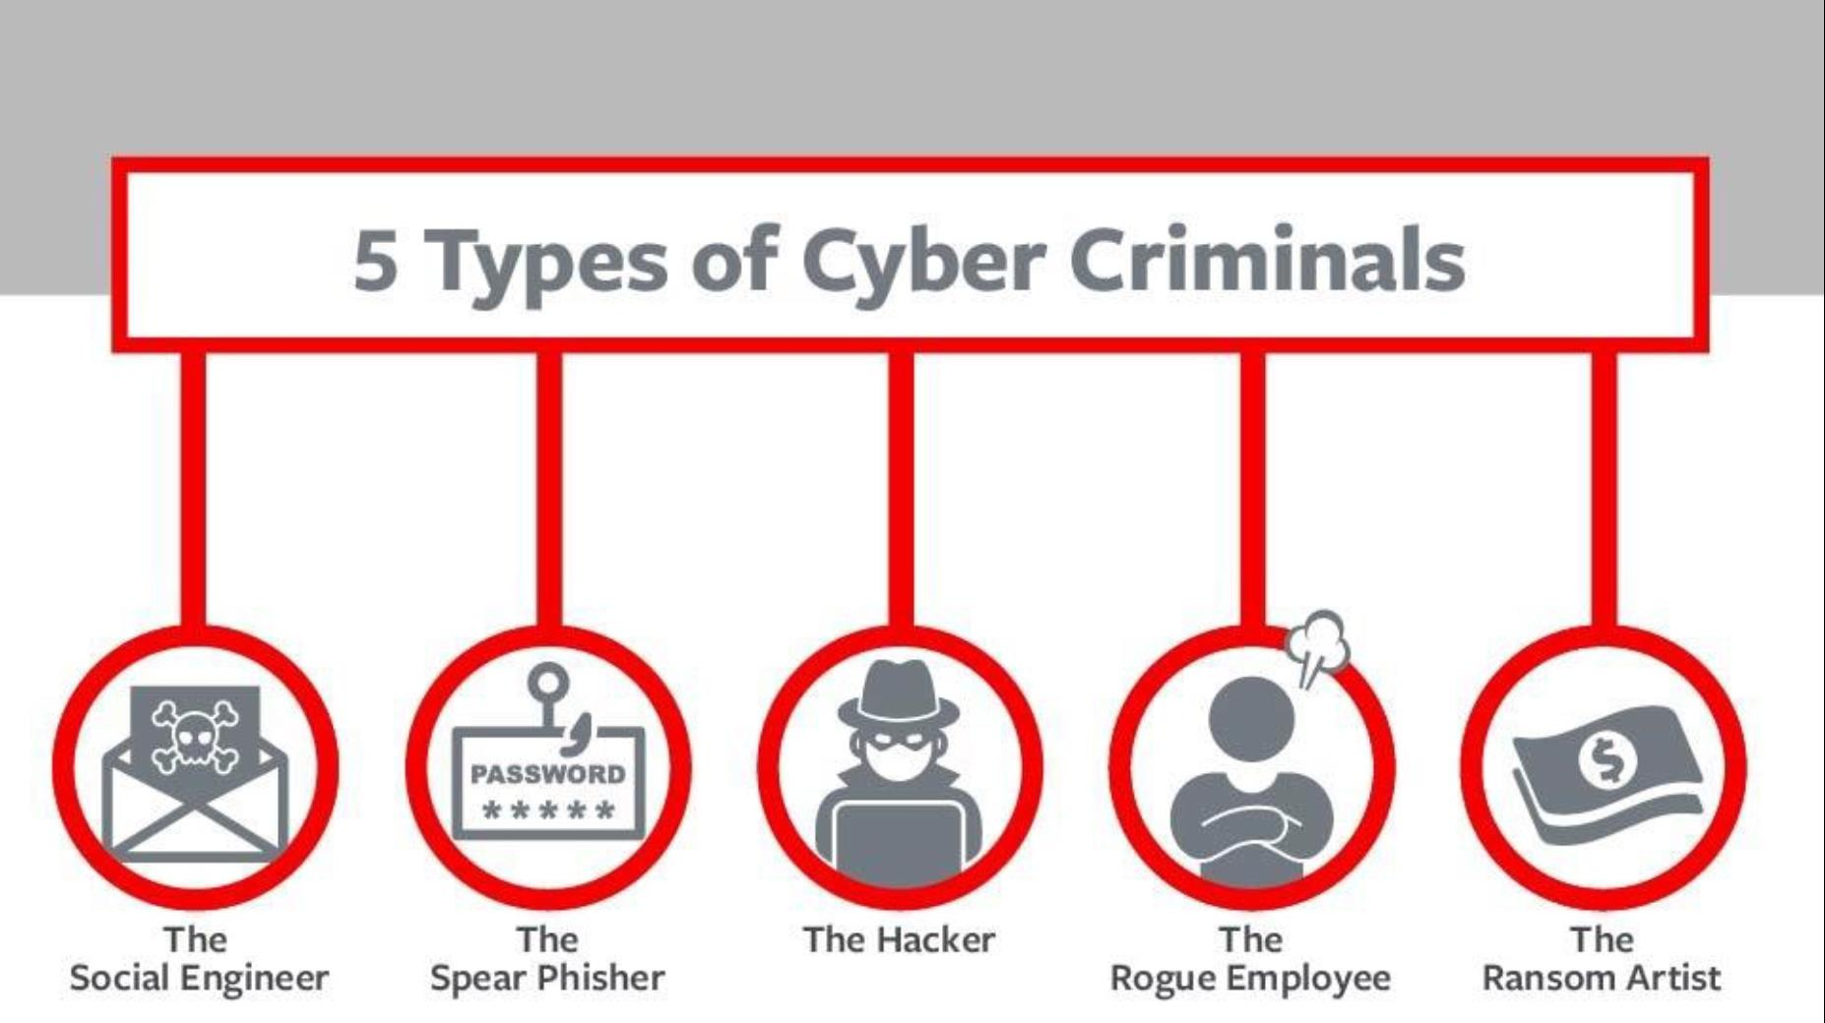

Slide 15
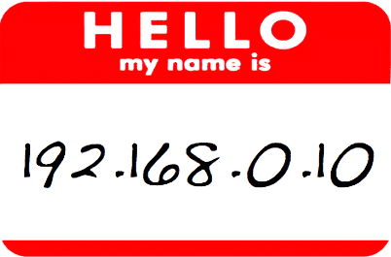
How do you look like to Bad guys?
66.233.160.64

Slide 16
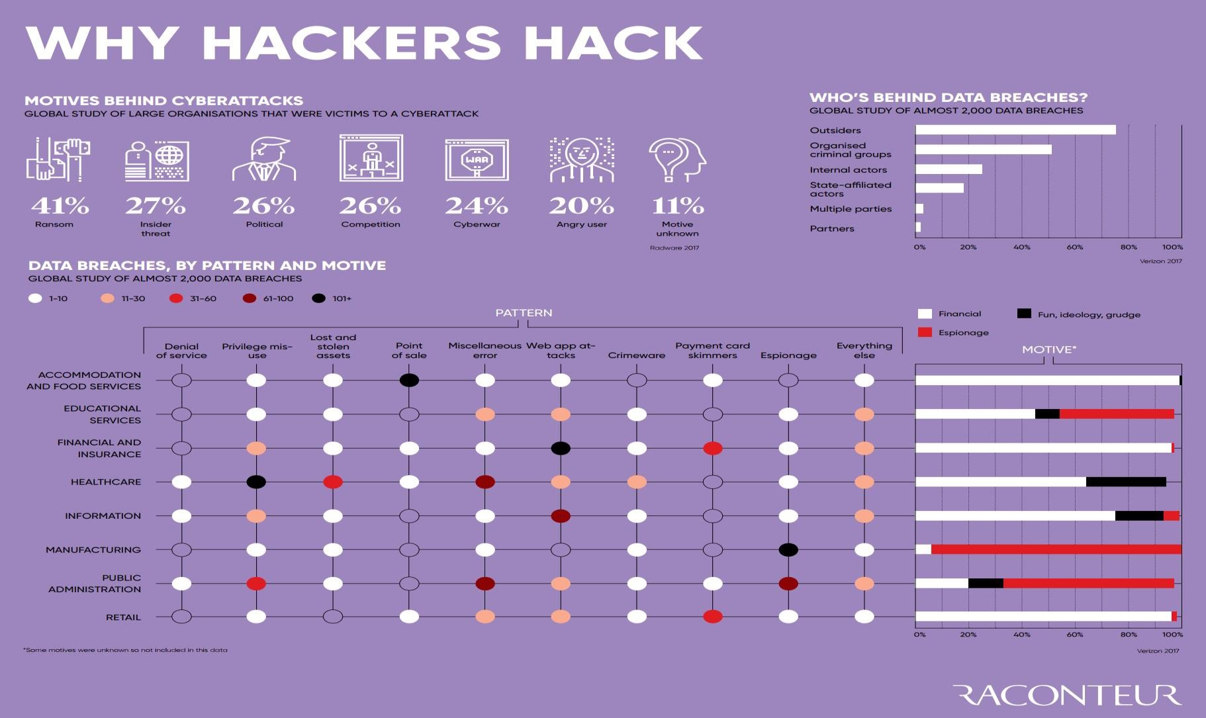

Hacking
◆ Financial (theft, fraud, blackmail)
◆ Political/State (state level/military)
◆ Fame/Kudos (fun/status)
◆ Hacktivism (cause)
◆ Pen Testers (legal hacking)
◆ Police
◆ Insider
◆ Business

Slide 17
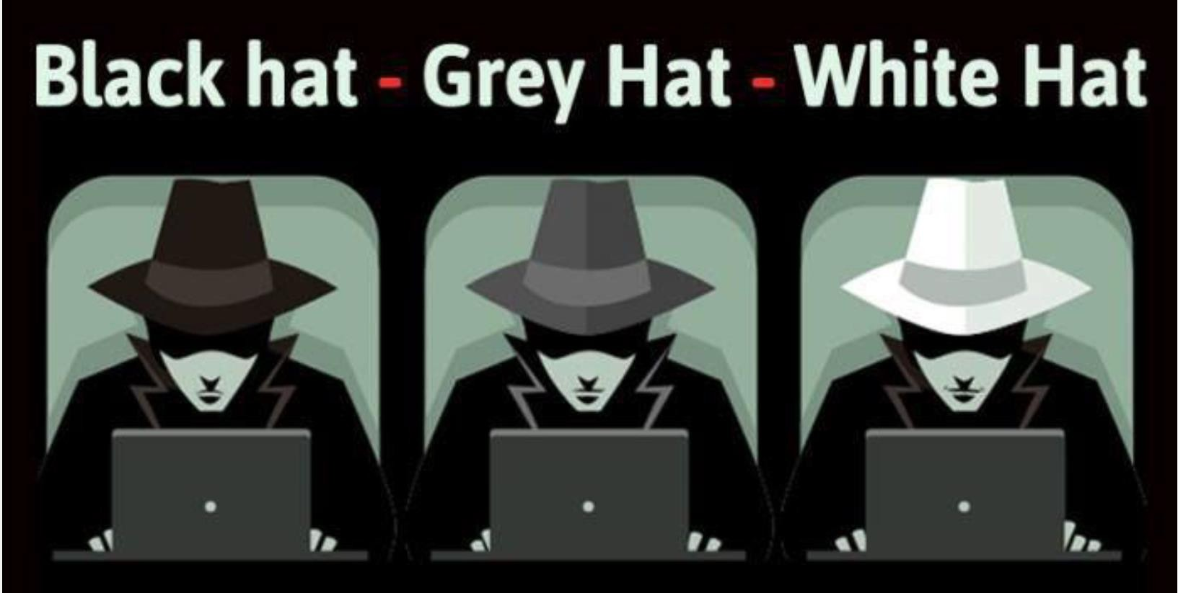
Which hat you want to wear?

Slide 18
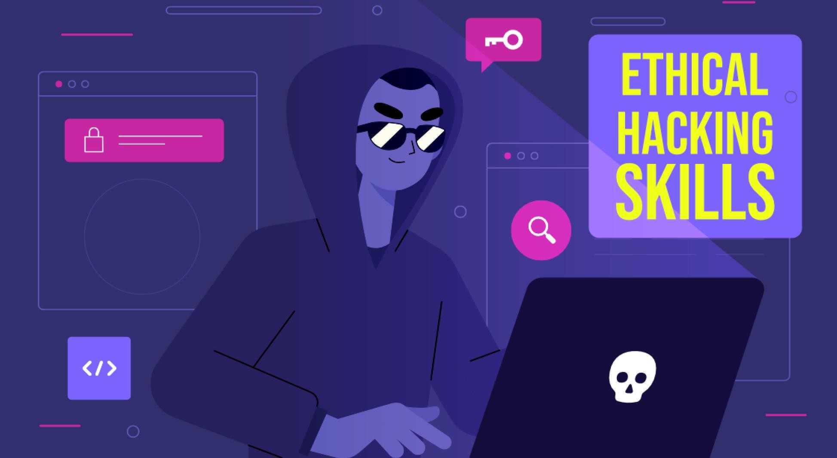
Ethical Hacking

Slide 19
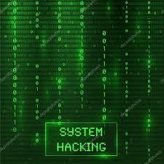
System Hacking
◆ System hacking is a vast subject that
consists of hacking the different software-
based technological systems such as laptops, desktops, etc.
◆ Here the malicious hacker exploits the weaknesses in a computer system or
network to gain unauthorized access to its data or take illegal advantage.
◆ Hackers generally use viruses, malware,
Trojans, worms, phishing techniques, email
spamming, social engineering, exploit
operating system vulnerabilities, or port vulnerabilities to access any victim’s system.

Slide 20
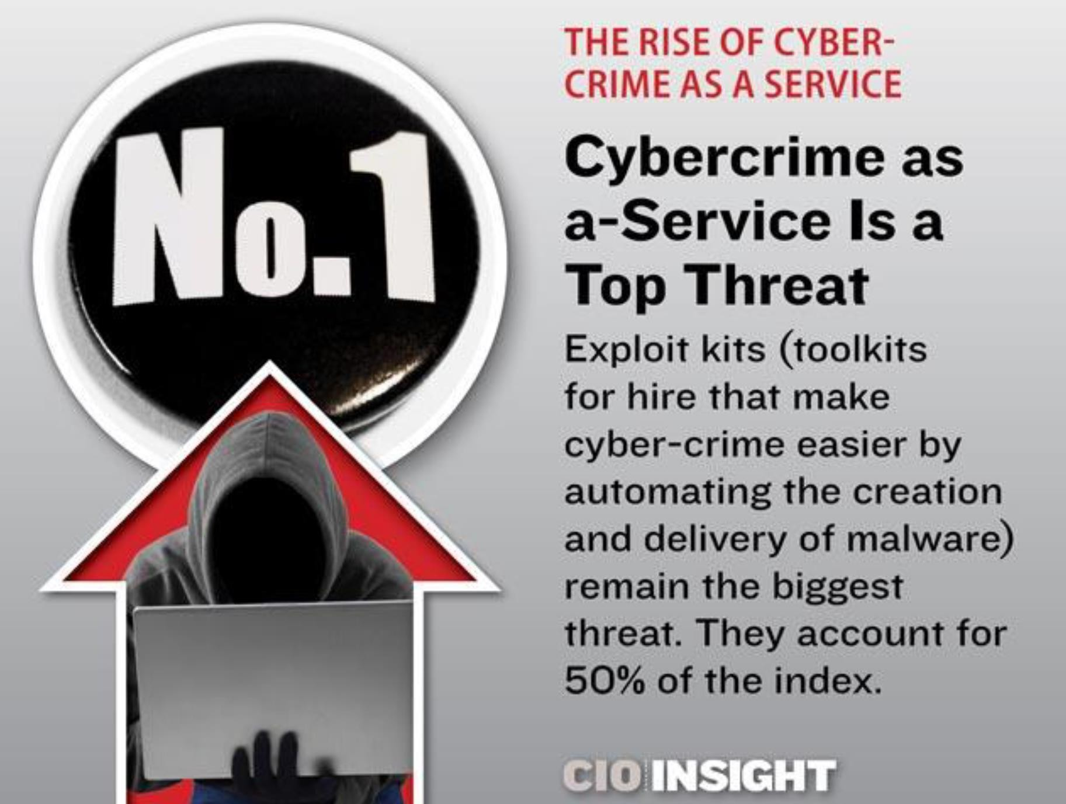
Cybercrime as a Service

Slide 21
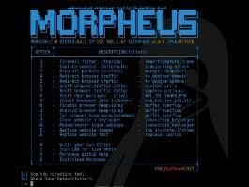
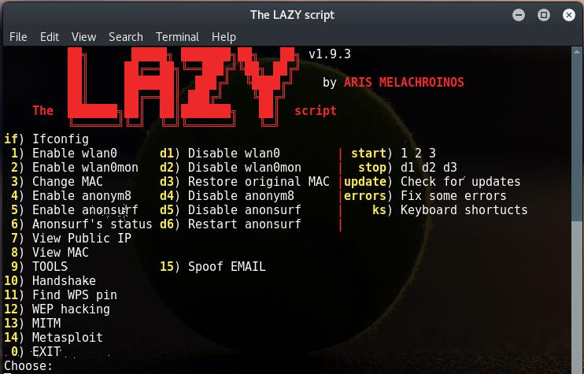
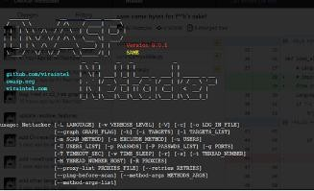
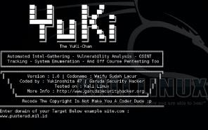
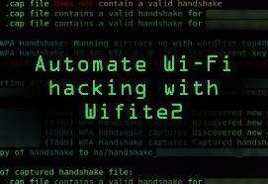
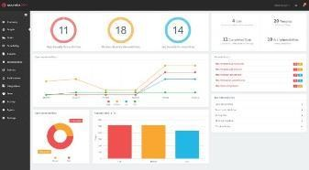
Attacks today are AUTOMATED!
It’s not some dude sitting at his hacker desk all day typing out ping commands to IP addresses via the command prompt manually…

Slide 22

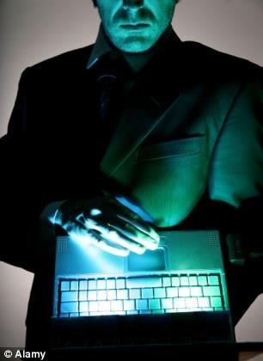

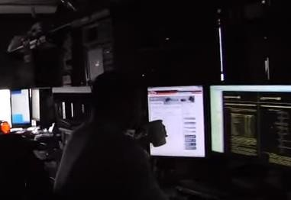

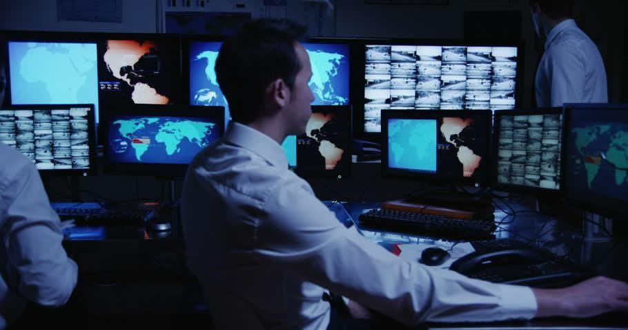
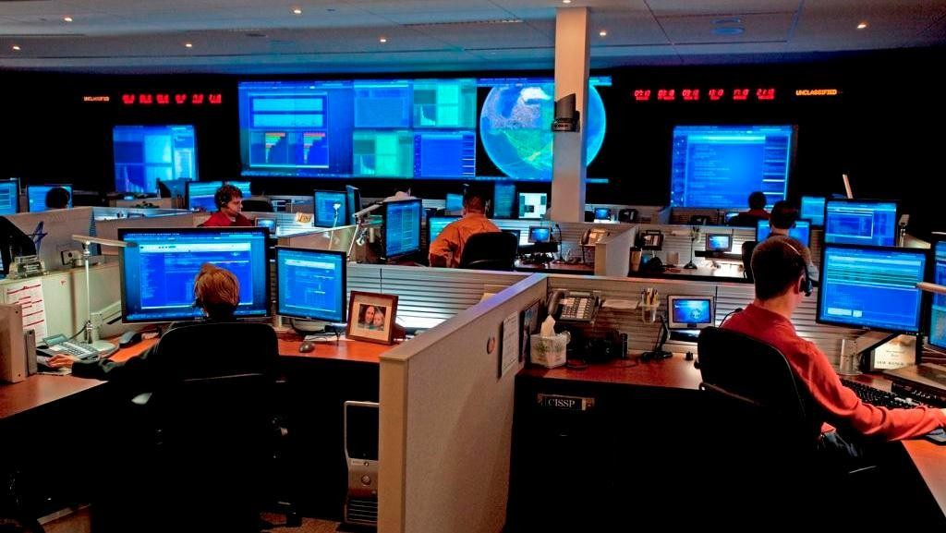
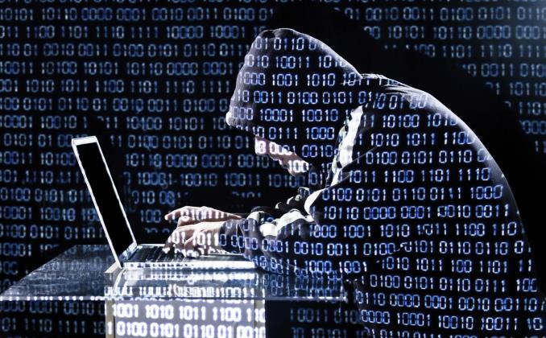
What does a Cyber Security Professional look like?

Slide 23
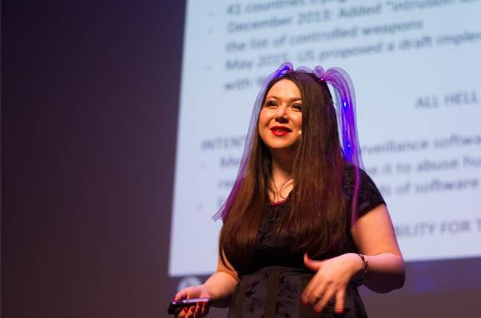

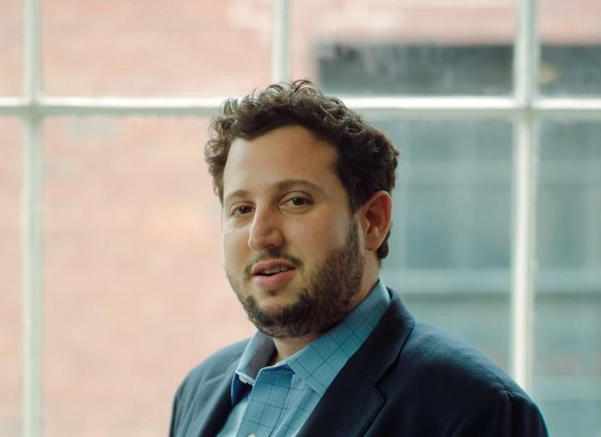


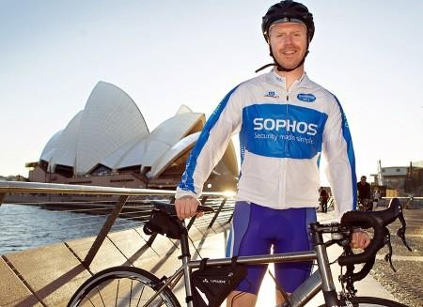
In reality…
David Ulevitch, Founder OpenDNS
Katie Moussouris, Microsoft Bug Bounty creator
Eugene Kaspersky, CEO Kaspersky Labs, £1.1bn
Dr Laura Toogood, MD Digitalis Reputation ₈
Erin Jacobs, CSO at UCB Financial Services
James Lyne, CTO, SANS

Slide 24
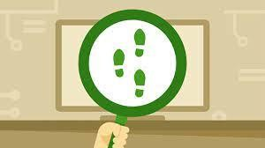
WHAT IS FOOTPRINTING?
◆ Definition: the gathering of information
about a potential system or network (the fine art of gathering target information)
◆ a.k.a. fingerprinting
◆ Attacker’s point of view
◆ Identify potential target systems
◆ Identify which types of attacks may be useful on target systems
◆ Defender’s point of view
◆ Know available tools
◆ May be able to tell if system is being
footprinted, be more prepared for possible attack
◆ Vulnerability analysis: know what
information you’re giving away, what
weaknesses you have

Slide 25
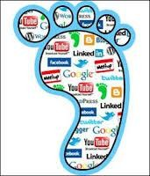
WHAT IS FOOTPRINTING?
◆ System (Local or Remote)
◆ IP Address, Name and Domain
◆ Operating System
◆ Type (Windows, Linux, Solaris, Mac)
◆ Version (XP/Vista/7/10, Redhat, Fedora, SuSe, Ubuntu, OS X)
◆ Usernames (and their passwords)
◆ File structure
◆ Open Ports (what services/programs are running on the system)
◆ Networks / Enterprises
◆ System information for all hosts
◆ Network topology
Gateways
Firewalls
Overall topology
◆ Network traffic information
◆ Specialized servers
◆ Web, Database, FTP, Email, etc.
◆ Social Media

Slide 26
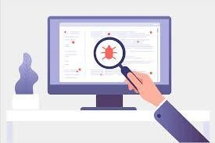
Vulnerability Scanner
◆ Functions of Vulnerability Scanner are far different from firewall or intrusion detection system.
◆ Vulnerability scanning tools helps you in protecting your organization from any kind of security risks or threats by scanning with deep inspection of endpoints to ensure that they are configured securely and correctly.
◆ The prime aim of running a vulnerability scanner is to identify the devices that are open for vulnerabilities.

Slide 27
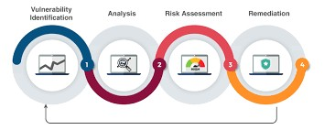
Types of Vulnerability Scanner
◆ Port scanner
◆ Network vulnerability scanner
◆ Web application security scanner
◆ Database security scanner.
◆ Host based vulnerability scanner
◆ ERP security scanner.
◆ Single vulnerability tests.

Slide 28
Virus Detection
Simple Anti-virus Scanners
  Look for signatures (fragments of known virus code)
  Heuristics for recognizing code associated with viruses
    Example: polymorphic viruses often use decryption loops
  Integrity checking to detect file modifications
  Keep track of file sizes, checksums, keyed HMACs of contents
Generic decryption and emulation
  Emulate CPU execution for a few hundred instructions, recognize known virus body after it has been decrypted
  Does not work very well against viruses with mutating bodies and viruses
not located near beginning of infected executable

Slide 29
Virus Detection
Simple Anti-virus Scanners
  Look for signatures (fragments of known virus code)
  Heuristics for recognizing code associated with viruses
    Example: polymorphic viruses often use decryption loops
  Integrity checking to detect file modifications
  Keep track of file sizes, checksums, keyed HMACs of contents
Generic decryption and emulation
  Emulate CPU execution for a few hundred instructions, recognize known virus body after it has been decrypted
  Does not work very well against viruses with mutating bodies and viruses
not located near beginning of infected executable

Slide 30

Summary
Cybersecurity will require a significant workforce with deep domain knowledge.
Almost everything is hooked up to the internet in some sort of form.
Recent events have widened the eyes of many security experts.
The ability to gain access to high security organizations, infrastructures or mainframes has frightened many people.
Could one click of the mouse start World War III?

Slide 31
Thank you!

